Slide 1
What technical materials do we use?
Split this into CanSat and GCS.
CanSat includes probe and container, the primary portions of this are XBee and antennae.
GS includes the base station XBee and GCS antenna.
So we have two major avenues, antennae and XBee.
Apart from this, we need to interface the XBee with microcontrollers. Often you’ll know broad information about the microcontroller but not the minor issues that will arise. So, we need a forum.
We will also need to register on this forum anonymously, so the purpose isn’t visible to other teams.
The main microcontrollers are Arduino and Teensy.
Firstly, a look at XBee radio modules:
XBee

Slide 2
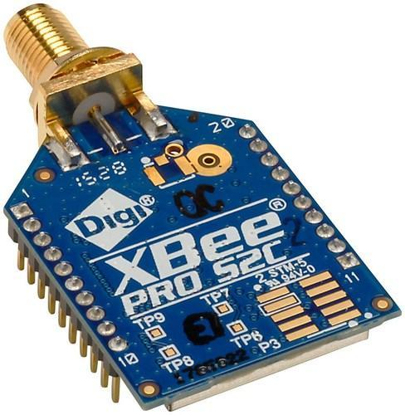
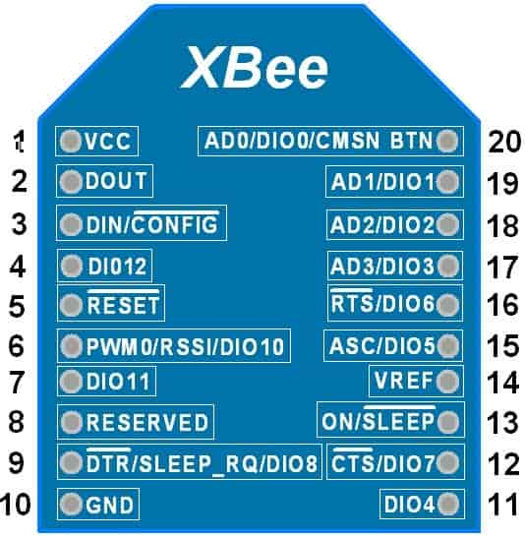
XBee Radios
XBee radios are basically RF signal transmitting modules. They work in the 2.4GHz band.
They’re manufactured bu DigiKey, a leading electronics manufacturer.
Structure and importance of the parts seen on the left.
Pinout and it’s significance.
What do the small markings on the left image mean?
How do I figure out the denotations on the pinout?
We can’t know everything about each and every marking. Google is not the way to refer the meanings, here we use the MANUFACTURER’S datasheet.
The datasheet includes several detailed discussions on every topic, what we need to learn is to distinguish between useful and useless info.

Slide 3
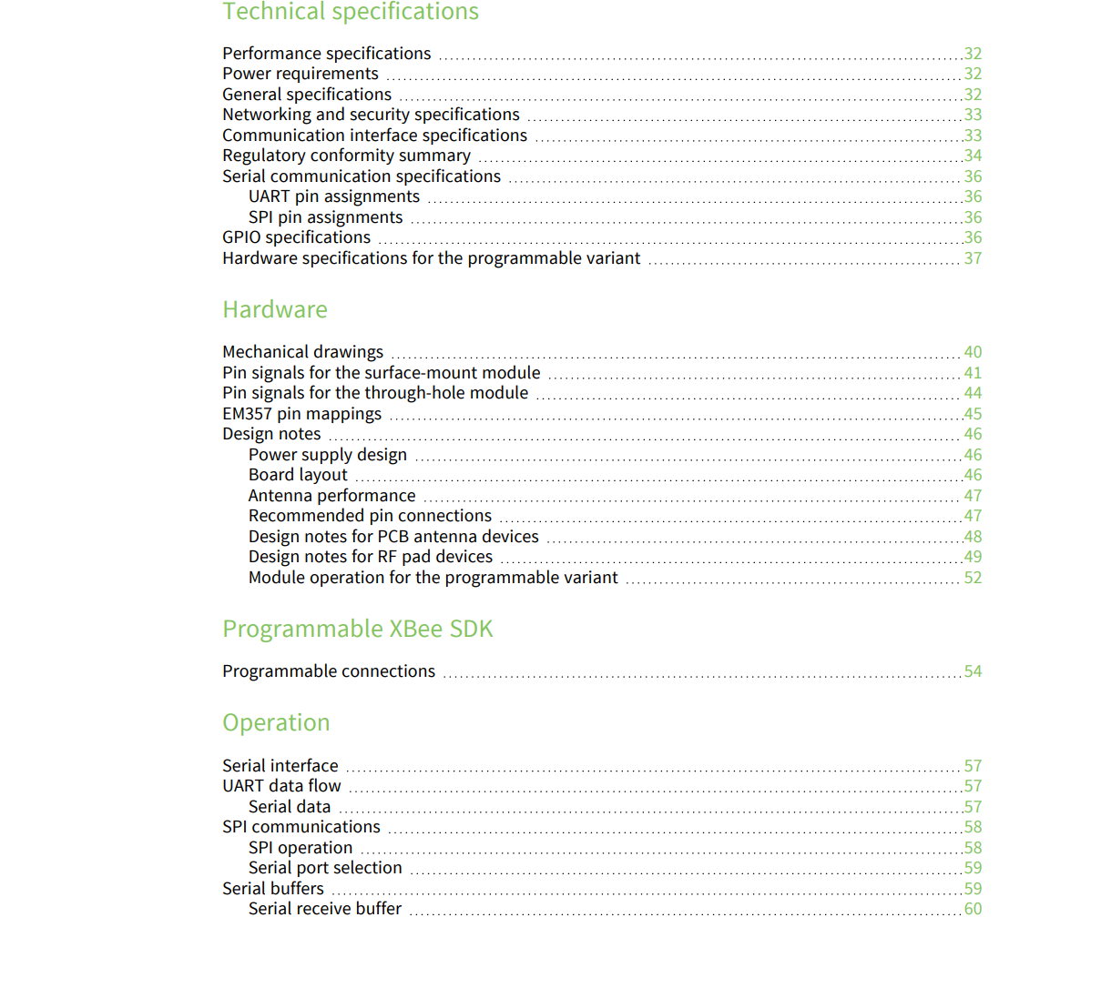
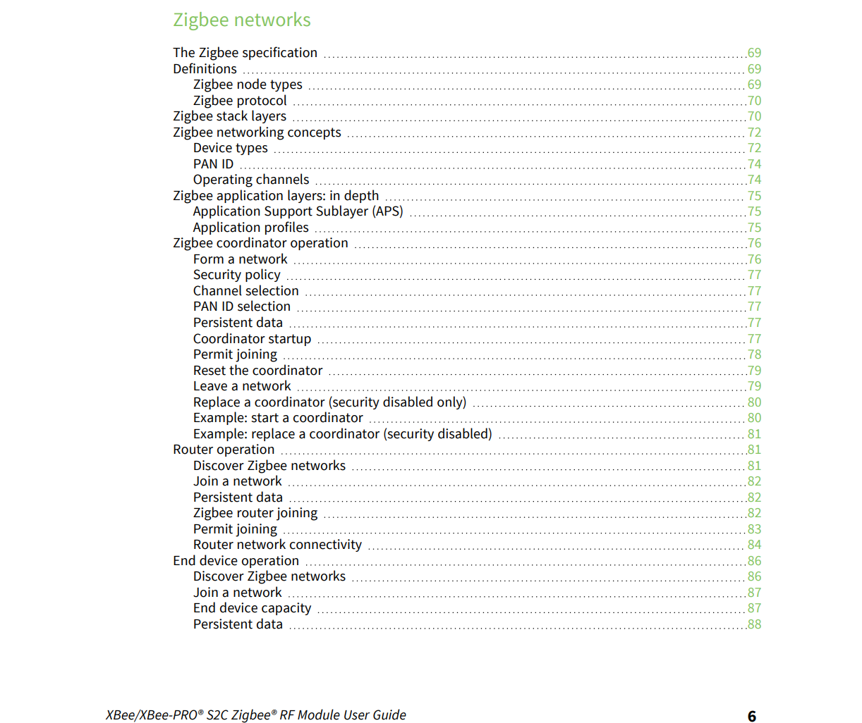
XBee Radios

Slide 4
Antennae
Necessity of antennae.
Where to select them from?
What should I look for when navigating the website?
How to spot a fake/useless website from a useful one?
How to understand an antenna datasheet
Antenna Trade Documentation
The number of factors you’ve to consider when buying/selecting one for your PDR.
Mock registration
Timeline

Slide 5
Documentation
Radio Config
Why use Excel sheets?
Why is it important to to document everything we do?
How to avoid waste of time when discussing
Enlisting the main sites where we’ve got to deal with
Appointing a coordinator.

